Slide 1
100% rotational speed (transonic)

Slide 2
Static pressure contour plot for different back pressure

Slide 3
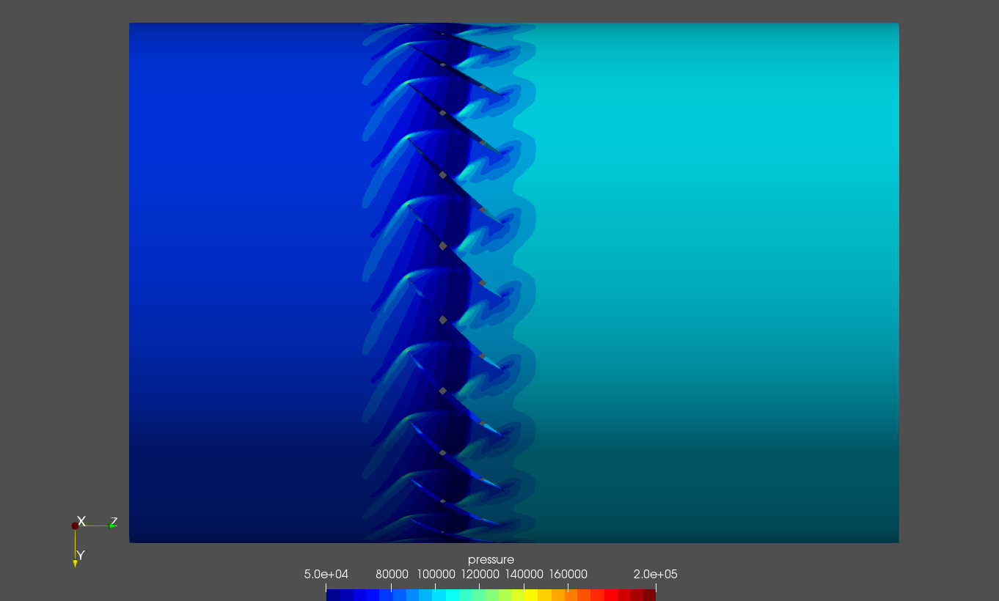
0kpa

Slide 4
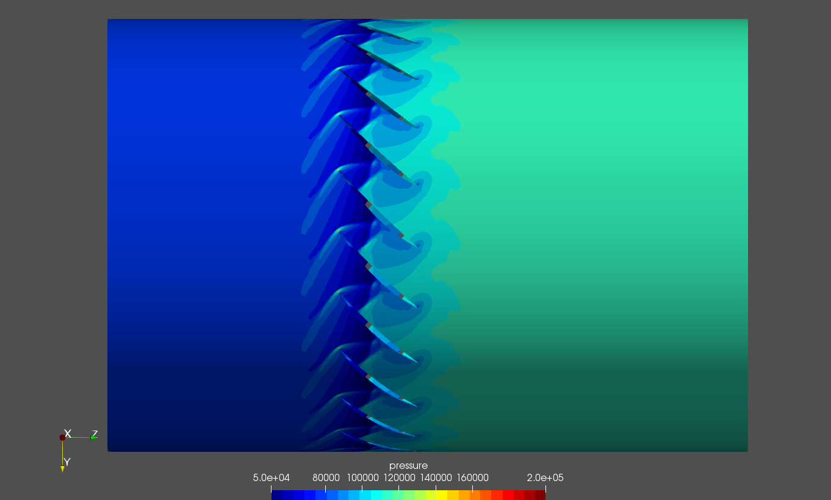
10kpa

Slide 5
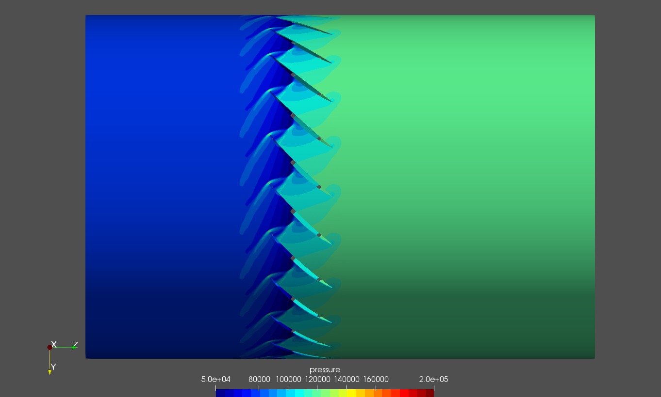
20kpa

Slide 6
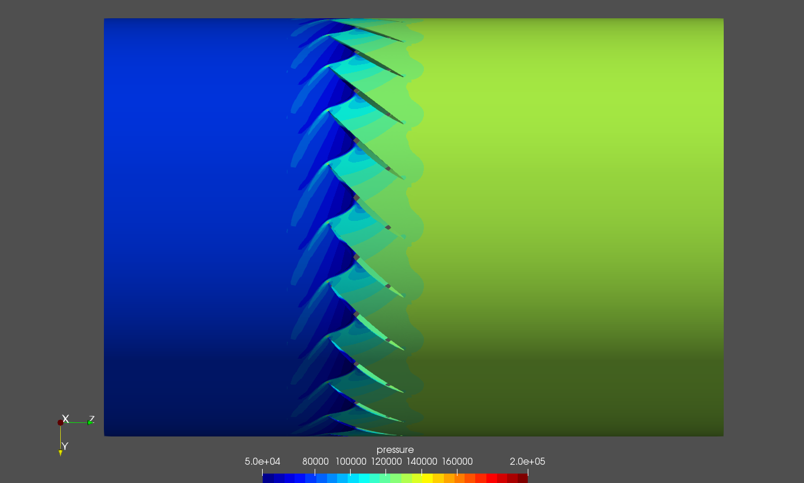
28kpa

Slide 7

29kpa

Slide 8
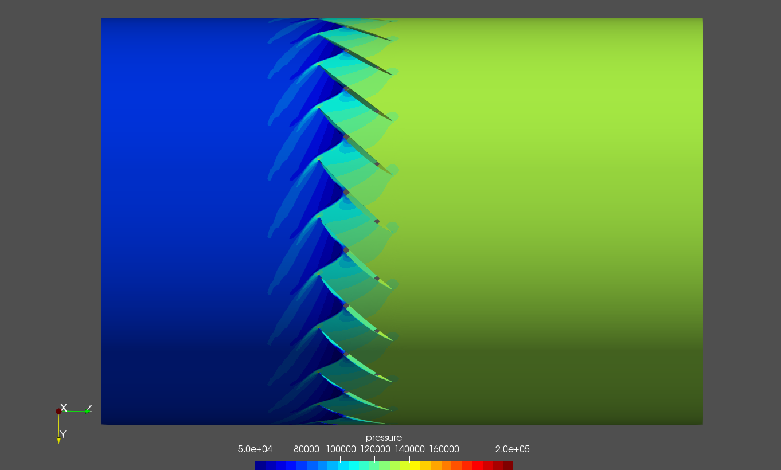
30kpa

Slide 9
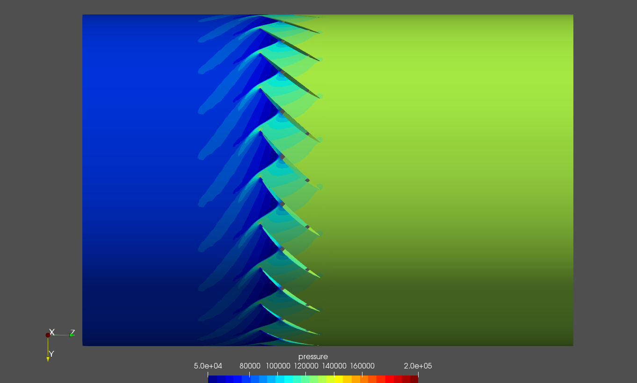
31kpa

Slide 10

31.1kpa

Slide 11

31.2kpa

Slide 12

31.3kpa

Slide 13

31.4kpa

Slide 14
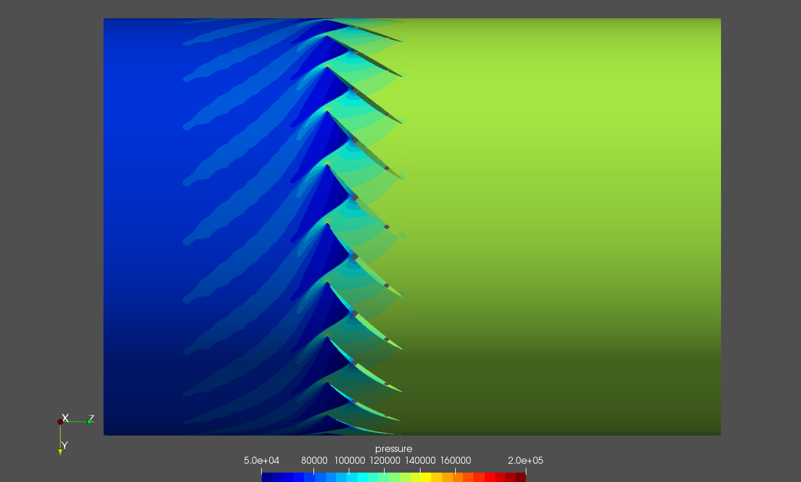
31.5kpa

Slide 15
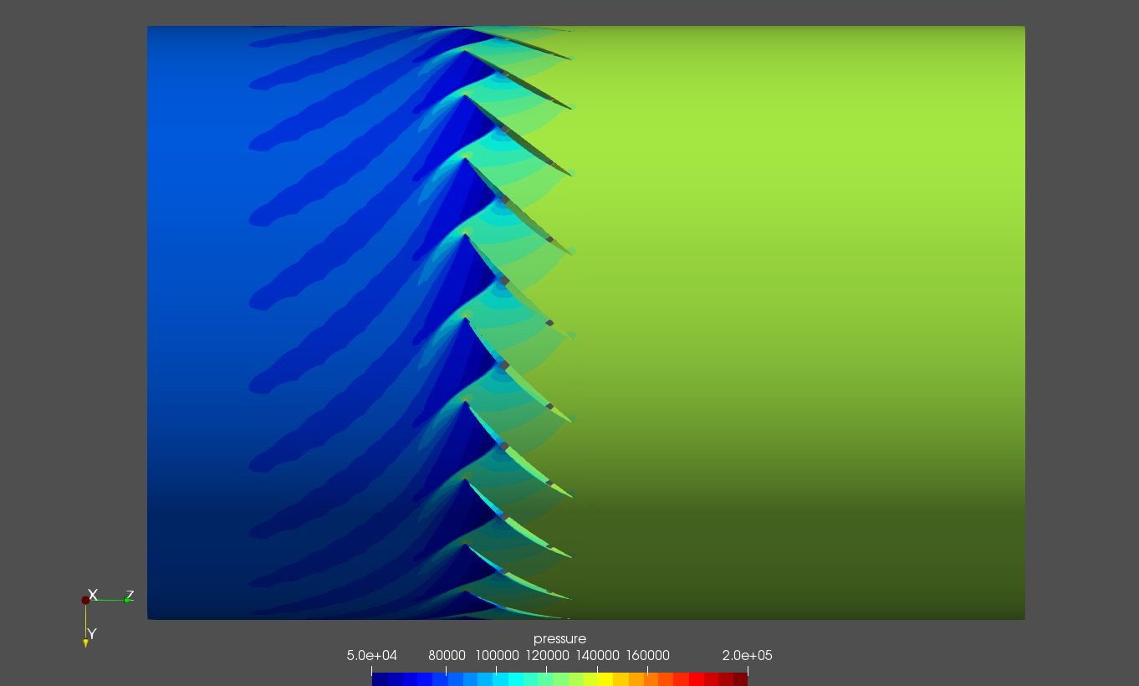
31.6kpa

Slide 16

31.7kpa

Slide 17

31.8kpa

Slide 18

31.9kpa

Slide 19
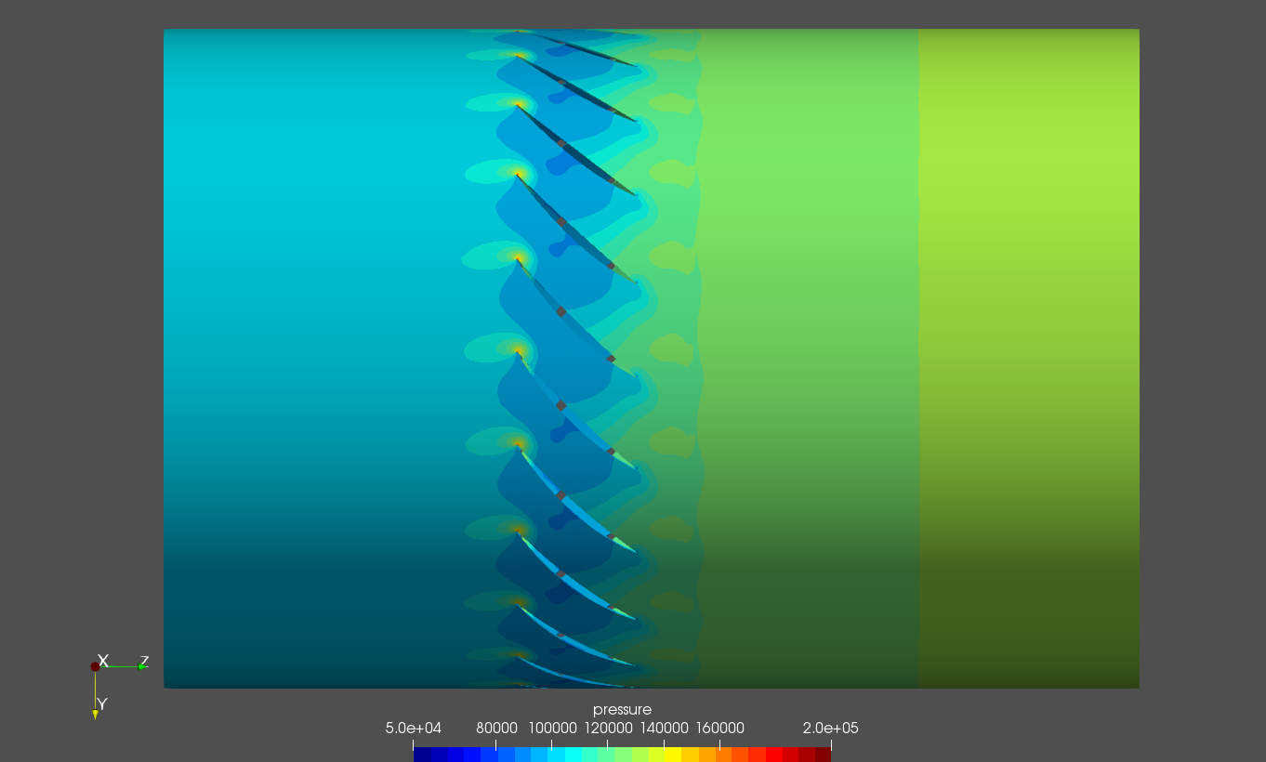
32kpa

Slide 20
Relative Mach number contour plot for different back pressure

Slide 21
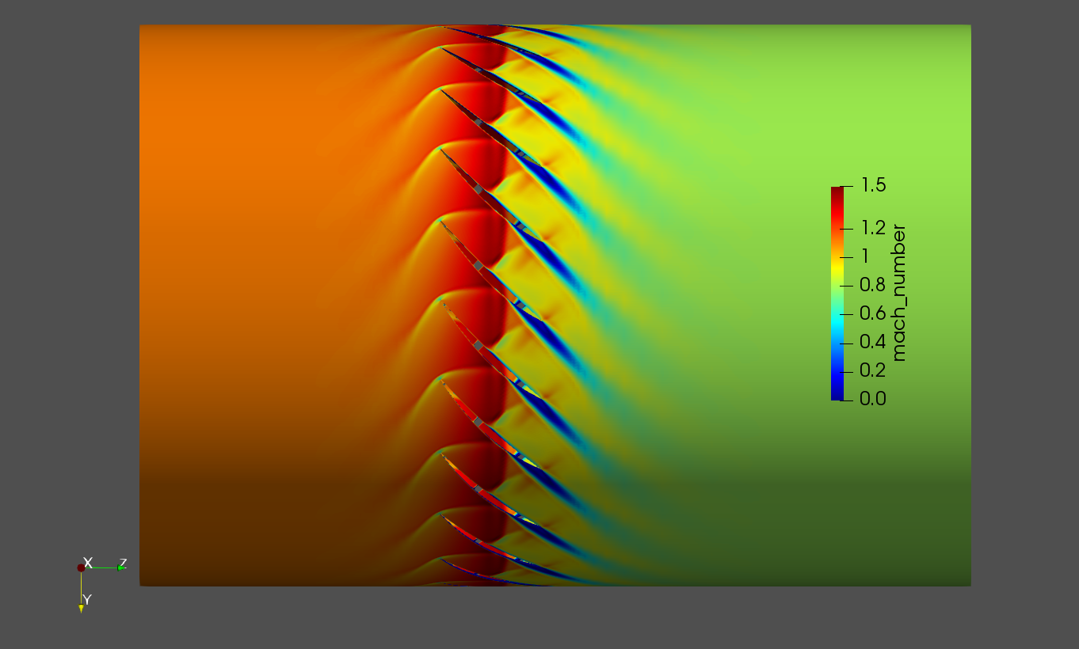
0kpa

Slide 22
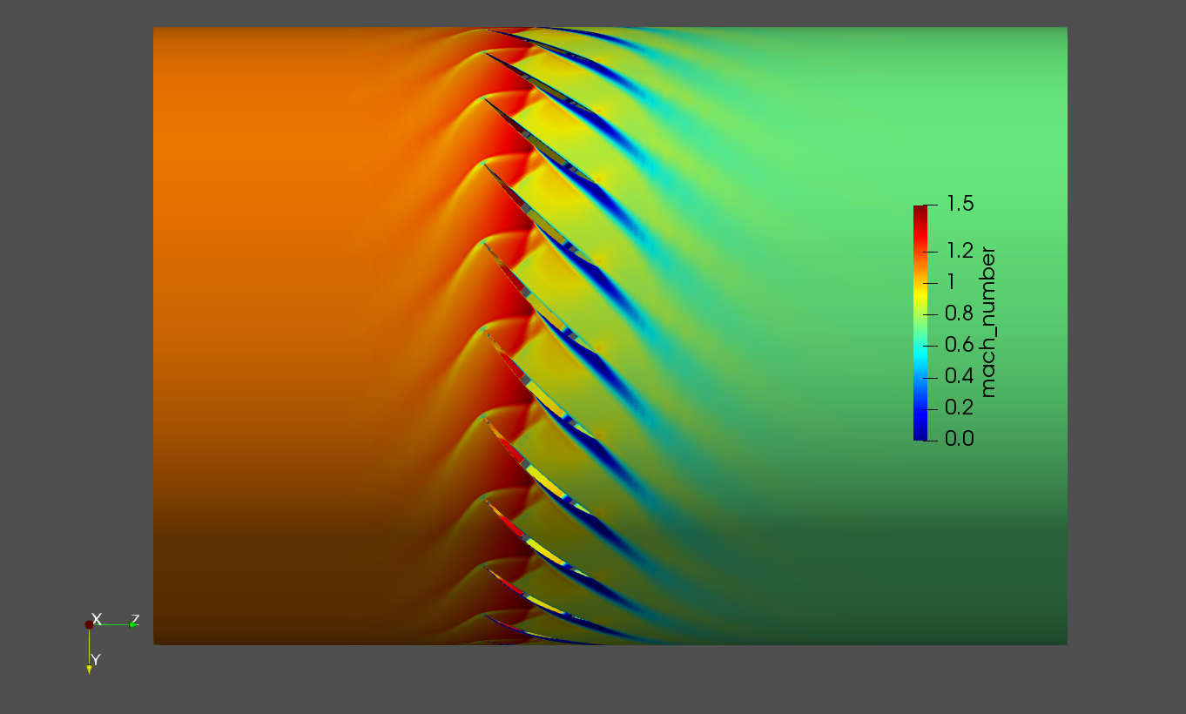
10kpa

Slide 23
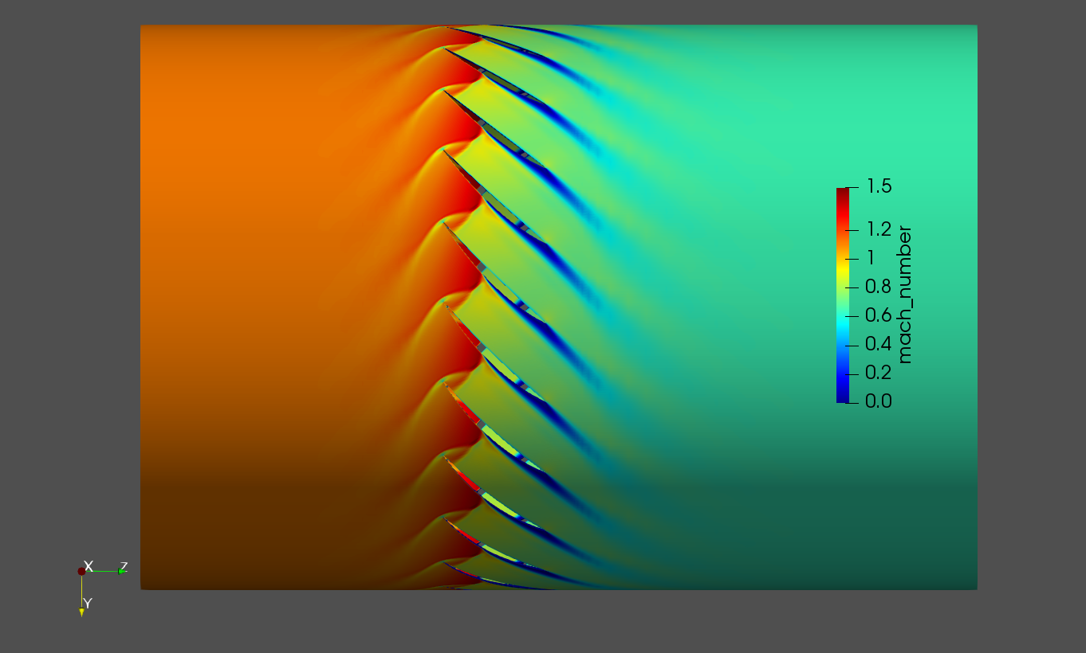
20kpa

Slide 24
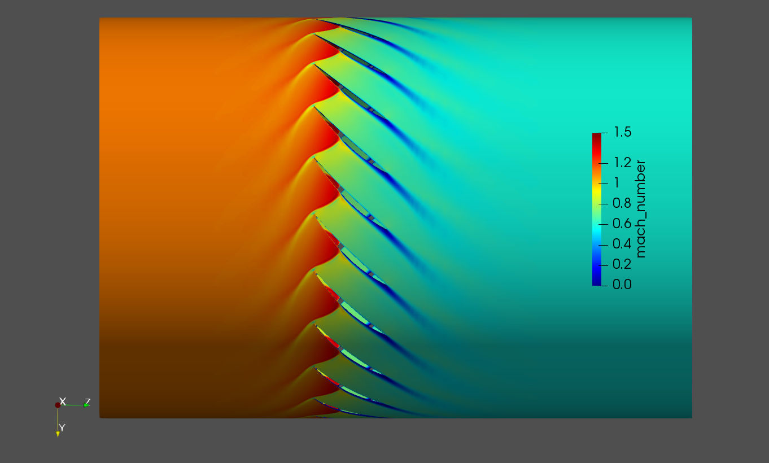
28kpa

Slide 25

29kpa

Slide 26
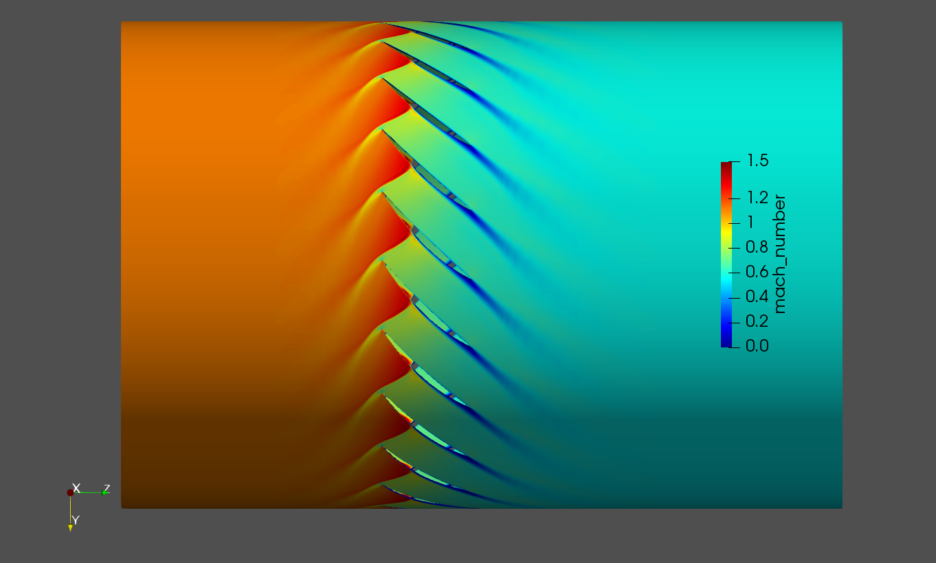
30kpa

Slide 27
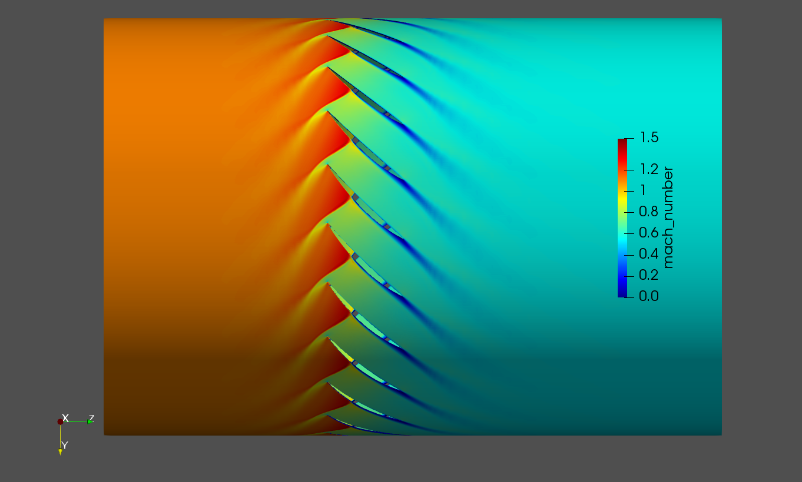
31kpa

Slide 28

31.1kpa

Slide 29
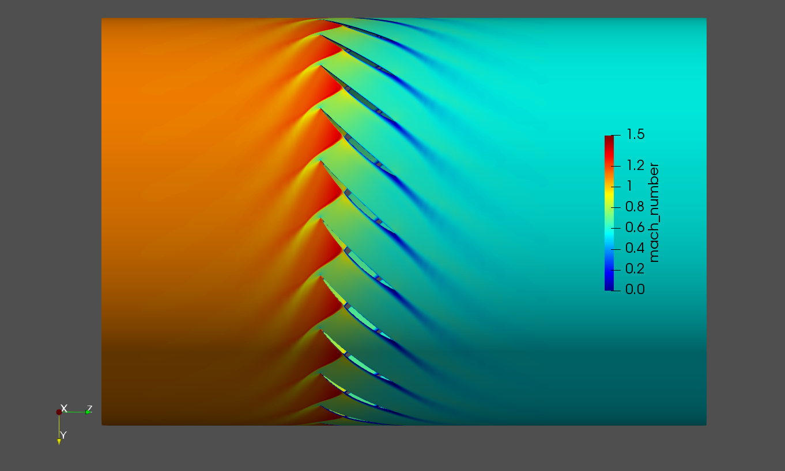
31.2kpa

Slide 30

31.3kpa

Slide 31

31.4kpa

Slide 32

31.5kpa

Slide 33

31.6kpa

Slide 34

31.7kpa

Slide 35
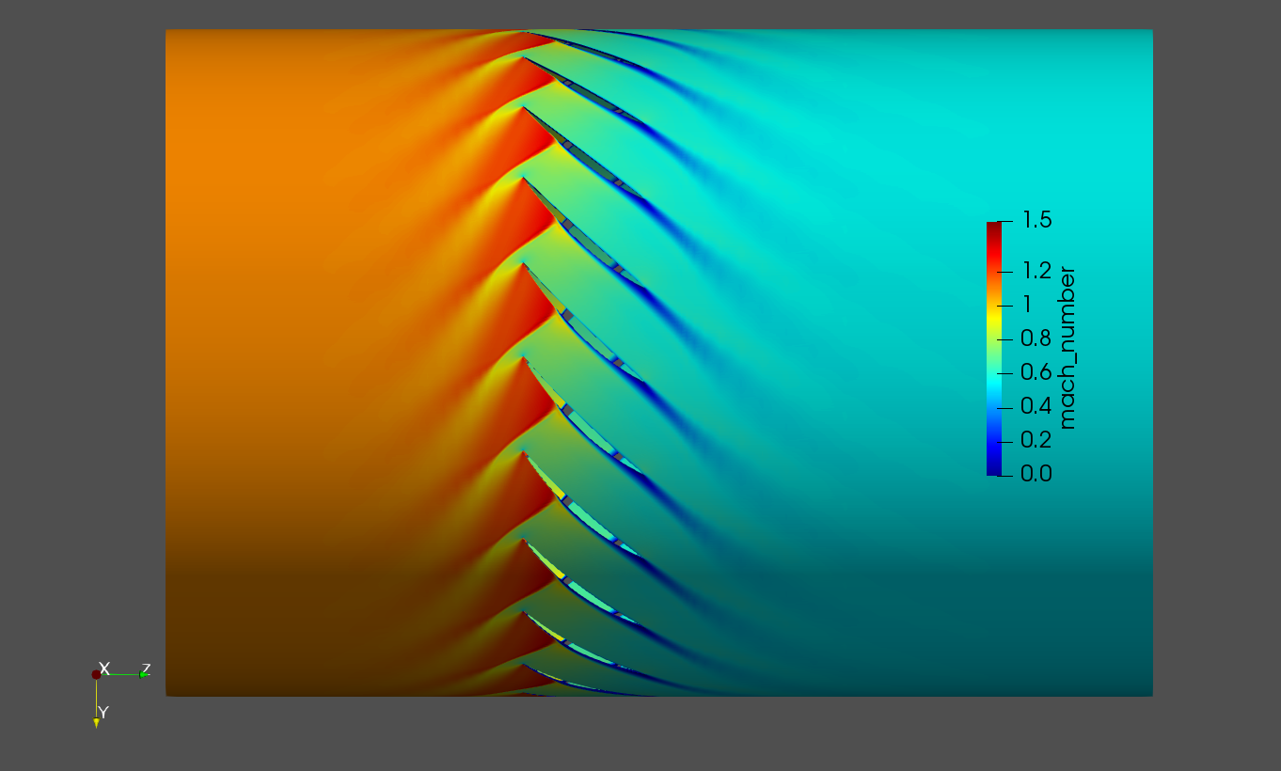
31.8kpa

Slide 36

31.9kpa

Slide 37
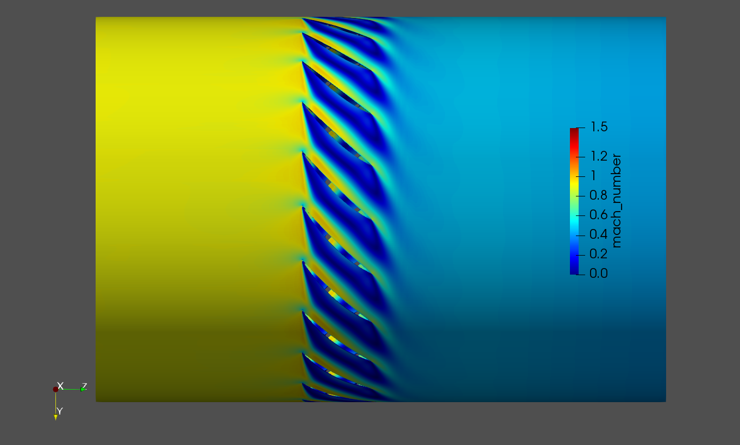
32kpa (steady state calc. did not converge)

Slide 38
Steady state performance
Pressure ratio efficiency

Slide 39
eigenvalues
Results are puzzling as no simple trend can be identified.
Almost all conditions are unstable…
Due to the unclear results for transonic cases, I decided to look at a simpler case at 50% rotational RPM where for the flow is subsonic.

Slide 40
Static pressure contour plot for different back pressure

Slide 41
50% rational speed (subsonic)

Slide 42
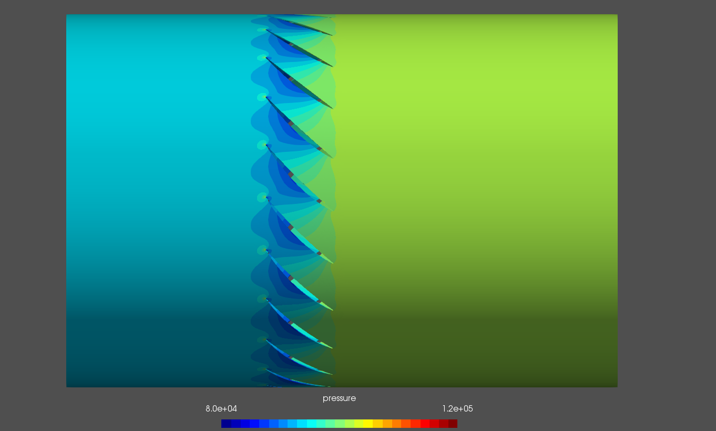
0kpa

Slide 43
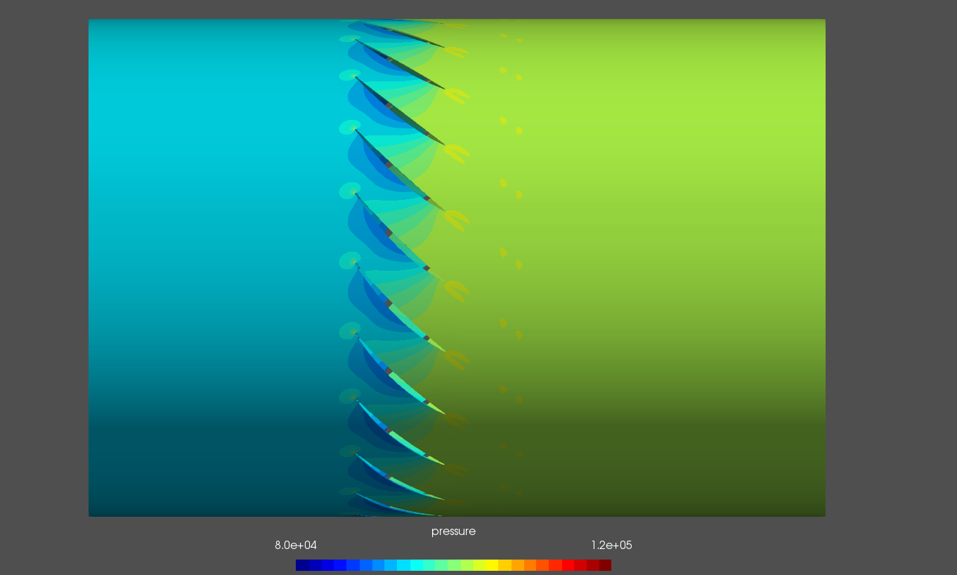
1kpa

Slide 44
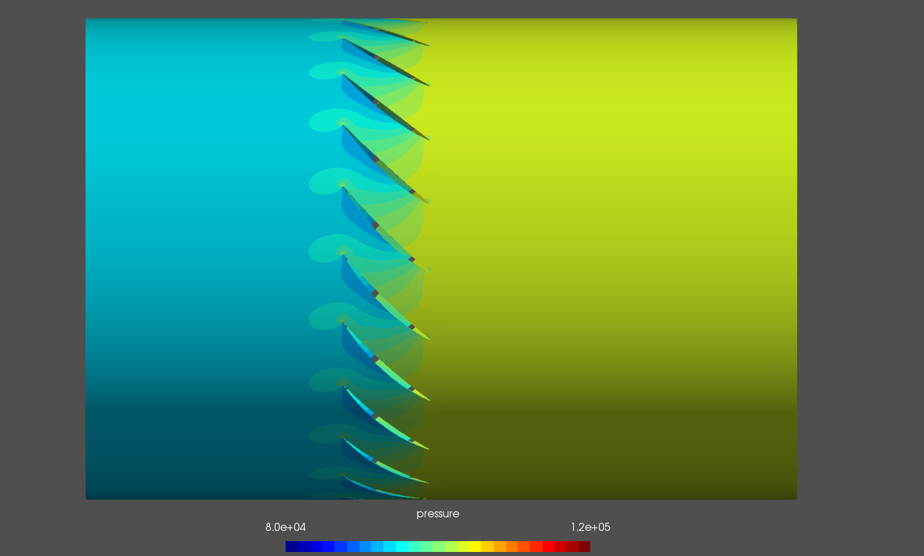
2kpa

Slide 45
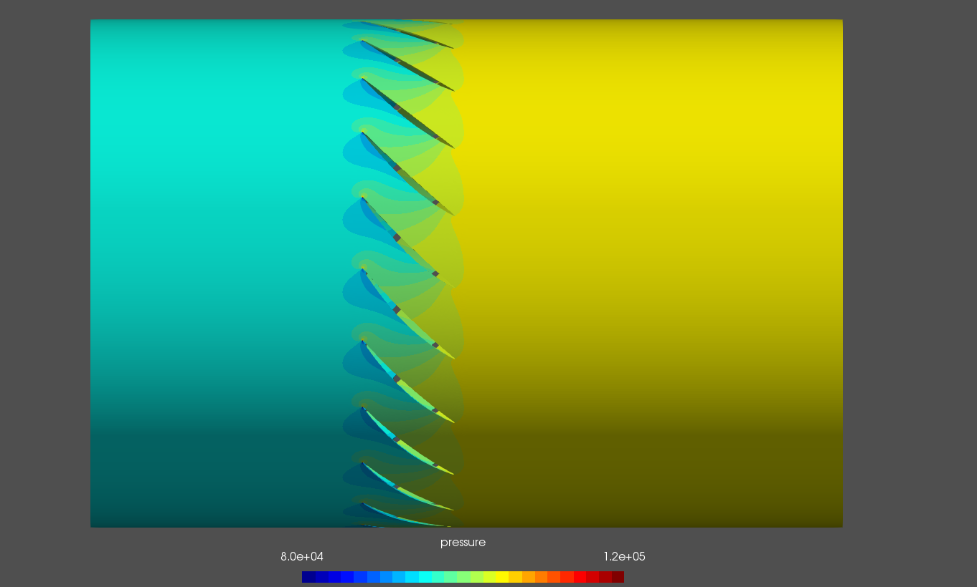
3kpa

Slide 46
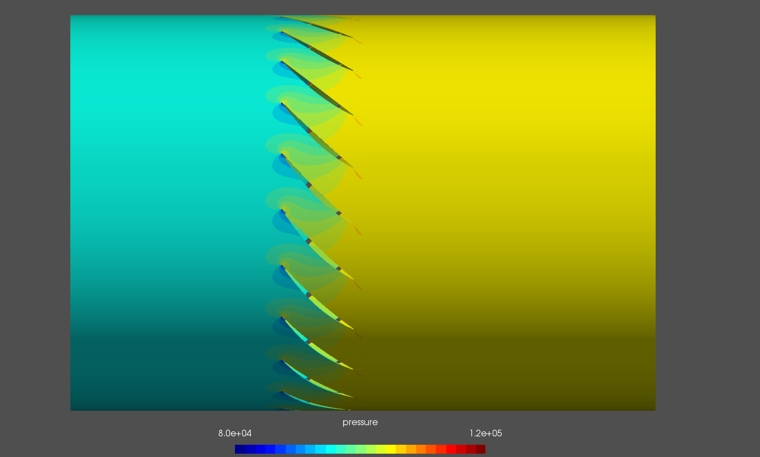
4kpa

Slide 47
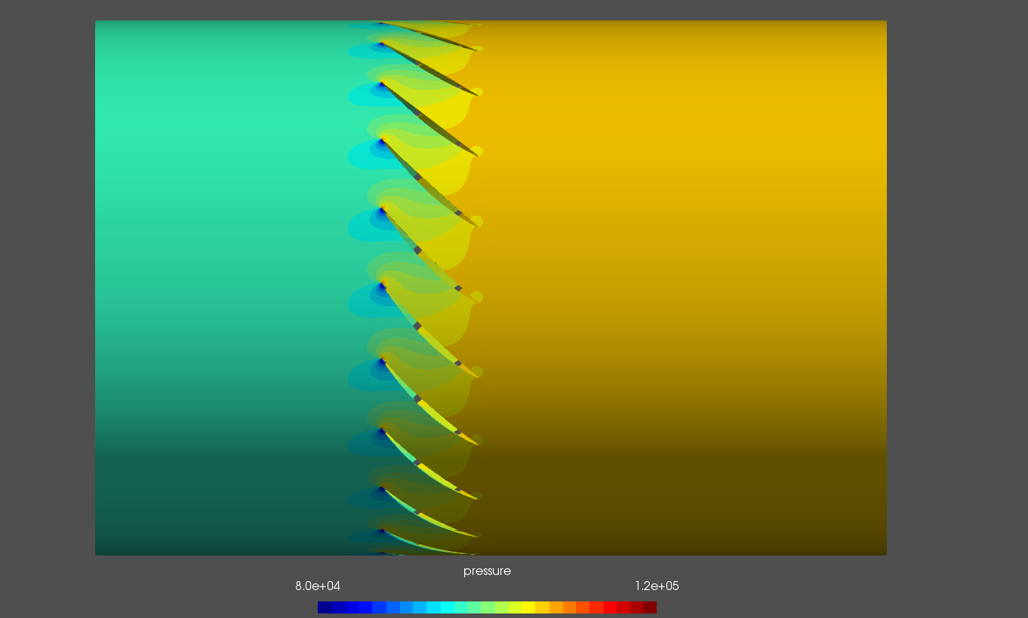
5kpa

Slide 48
Relative Mach number contour plot for different back pressure

Slide 49
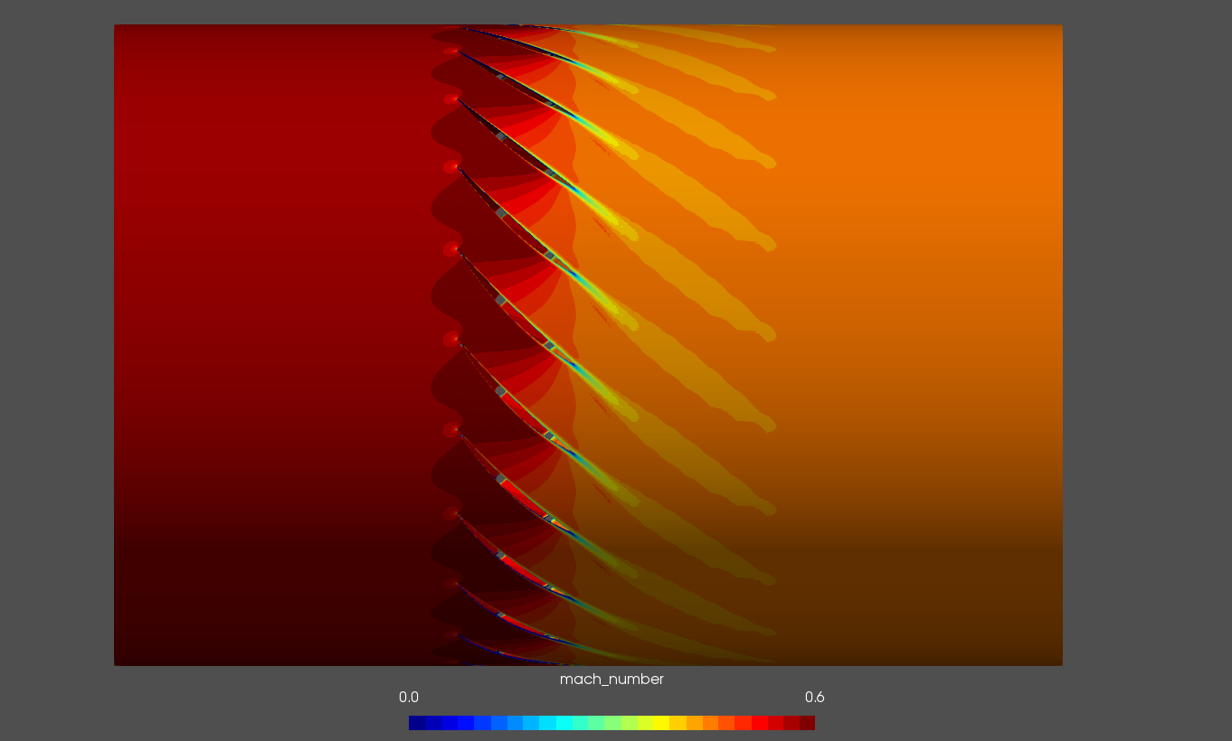
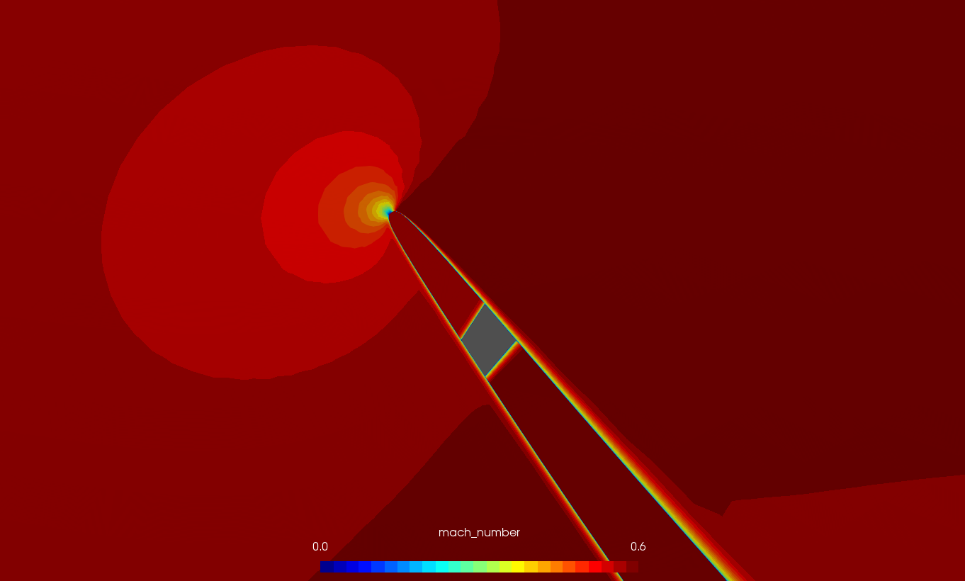
0kpa

Slide 50
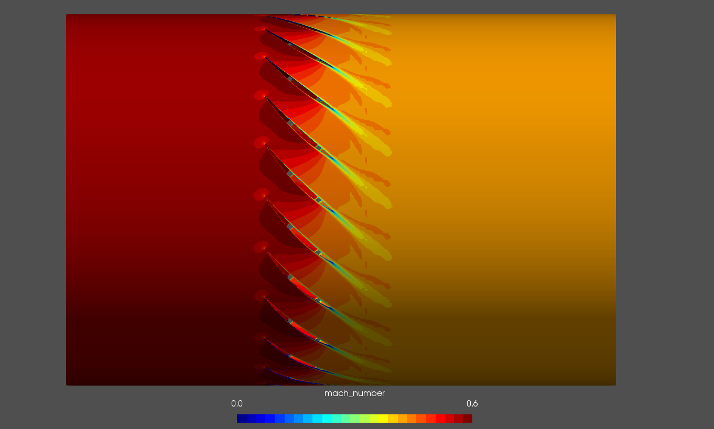
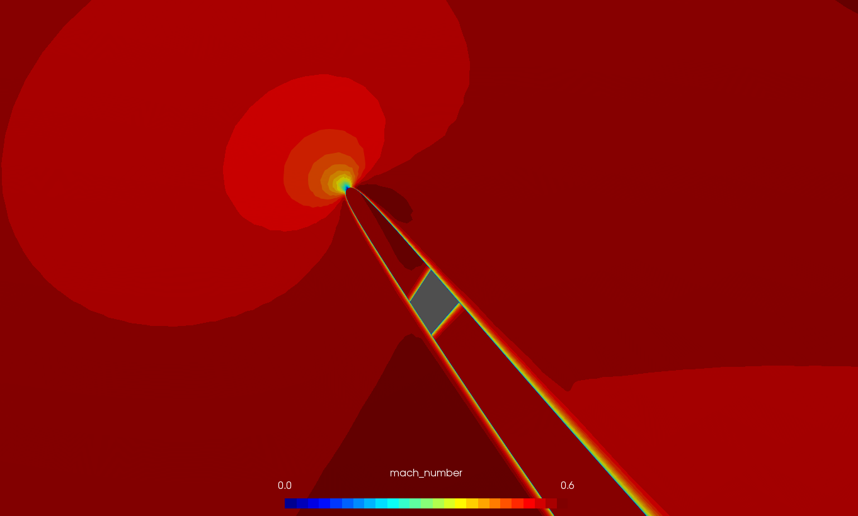
1kpa

Slide 51
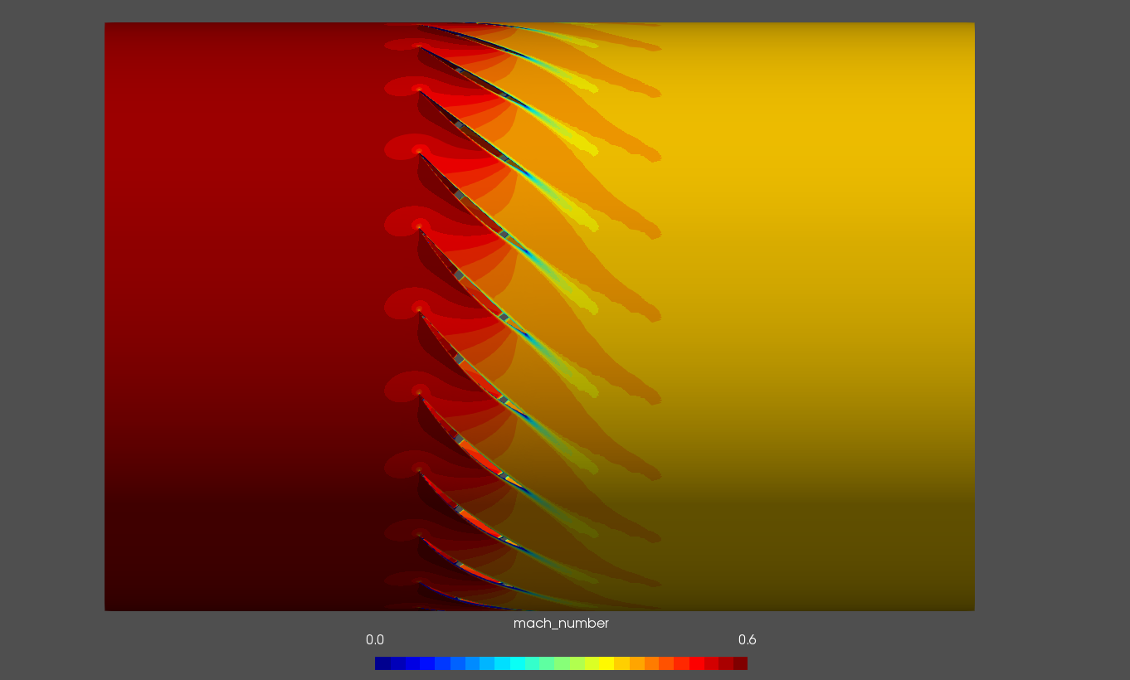
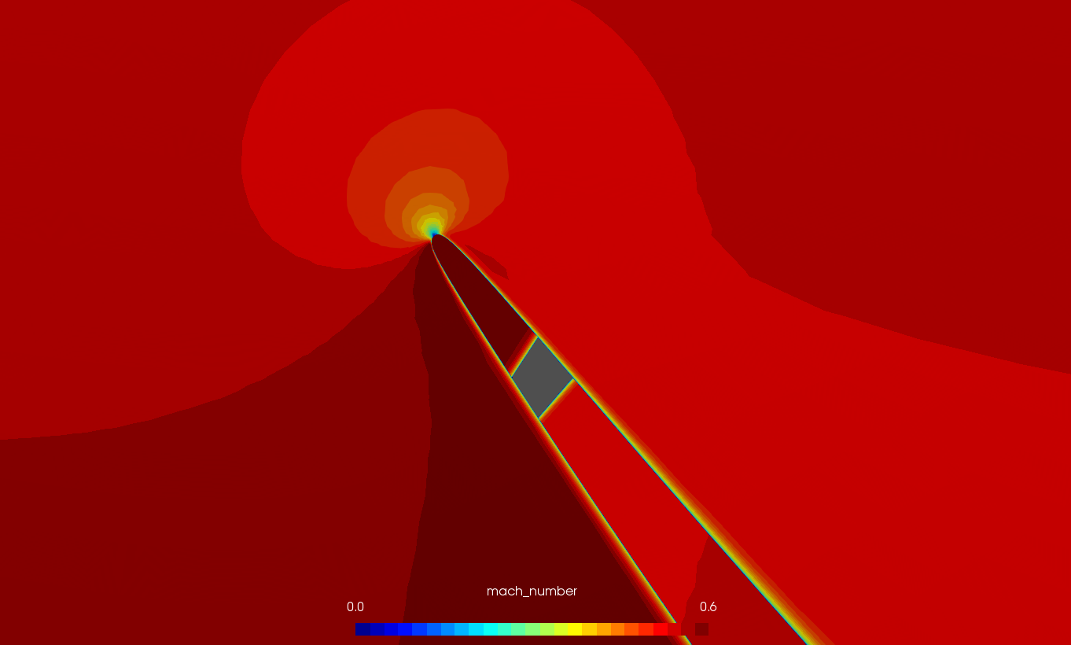
2kpa

Slide 52
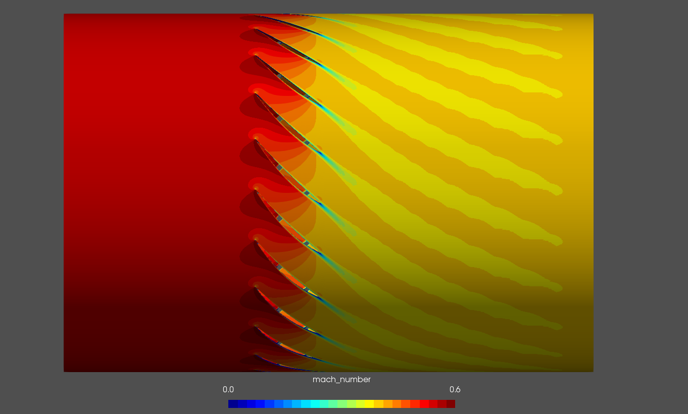
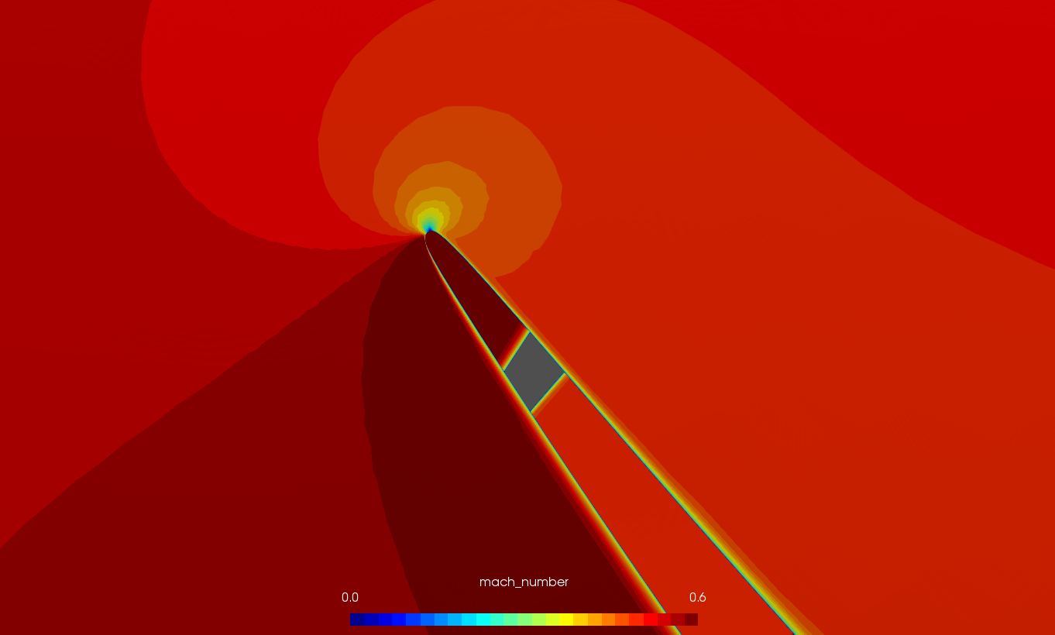
3kpa

Slide 53
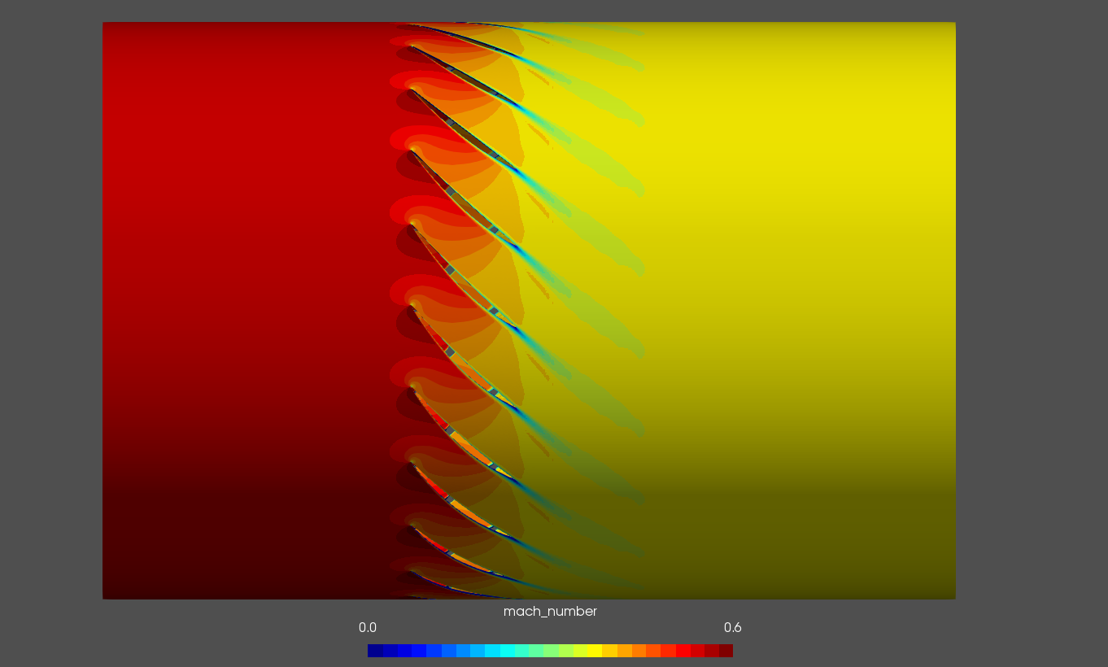
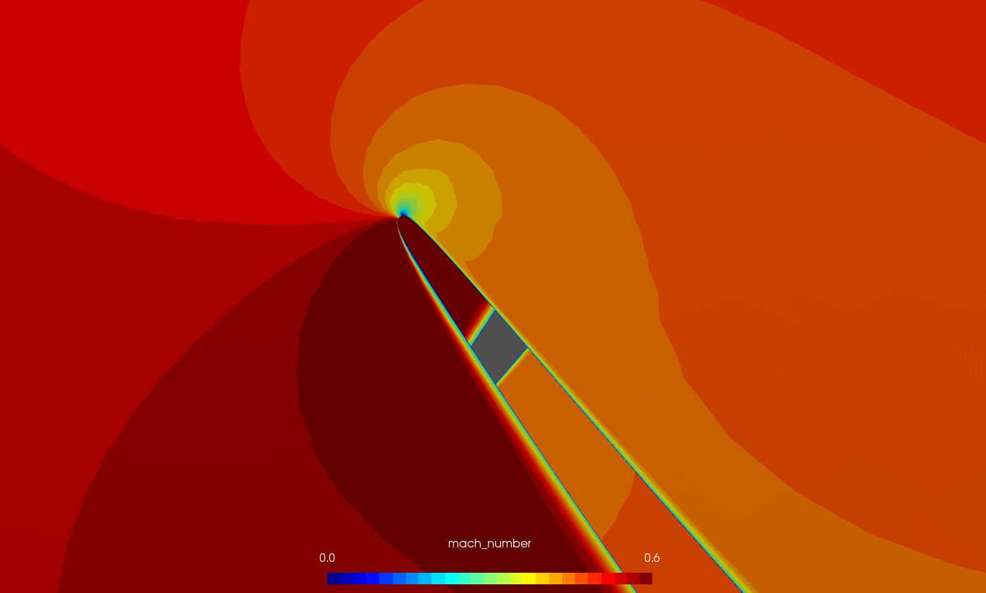
4kpa

Slide 54
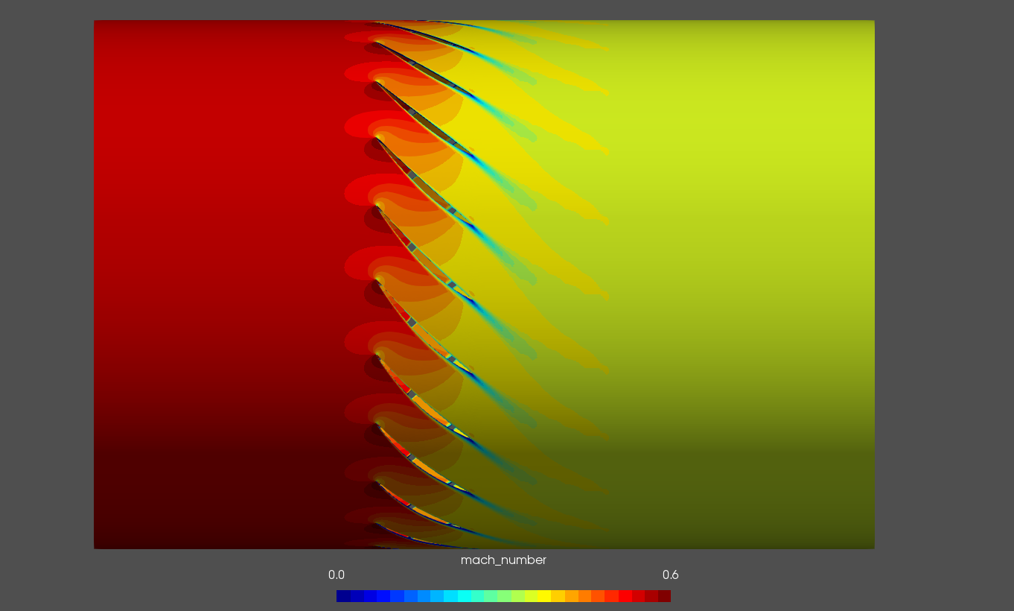
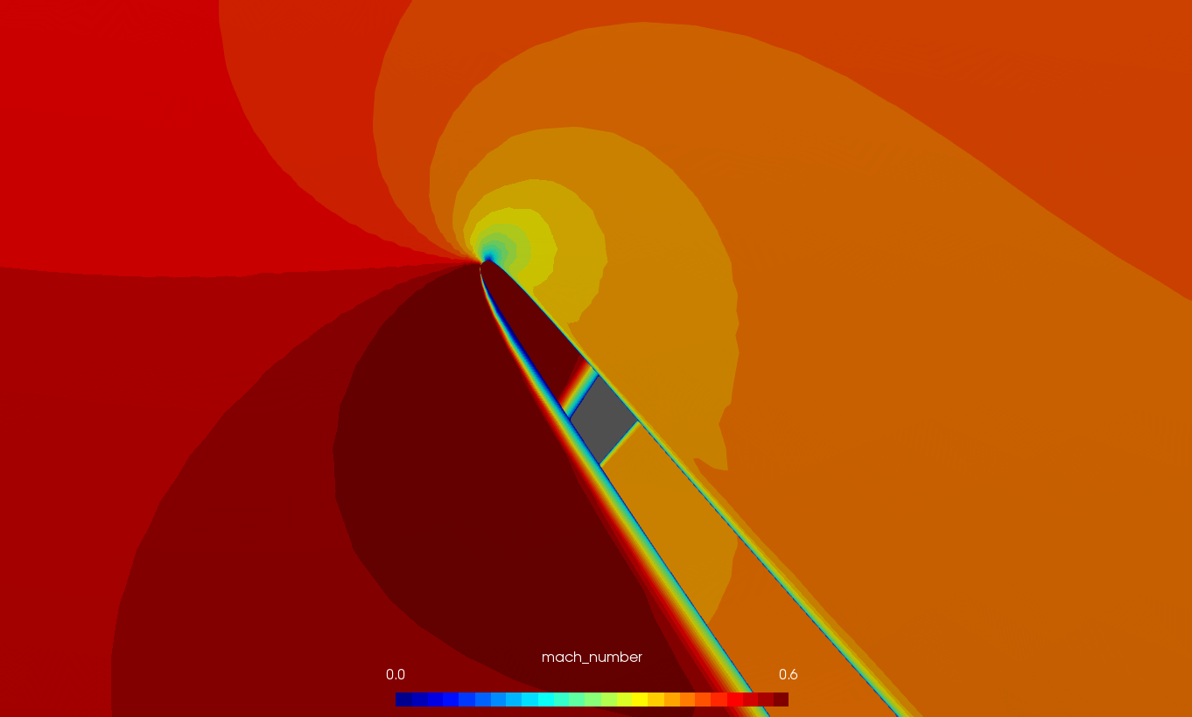
4.5kpa

Slide 55
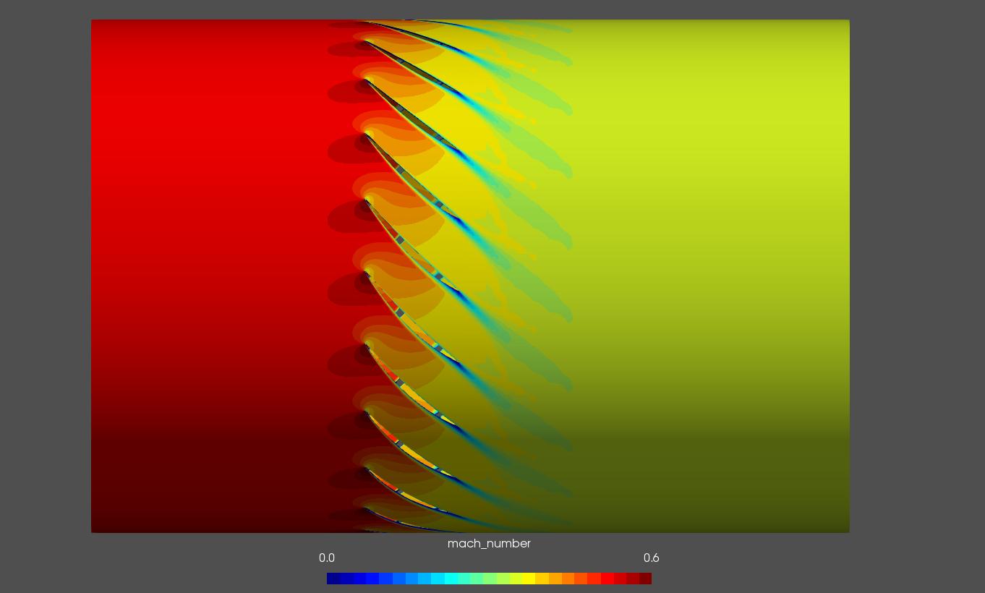
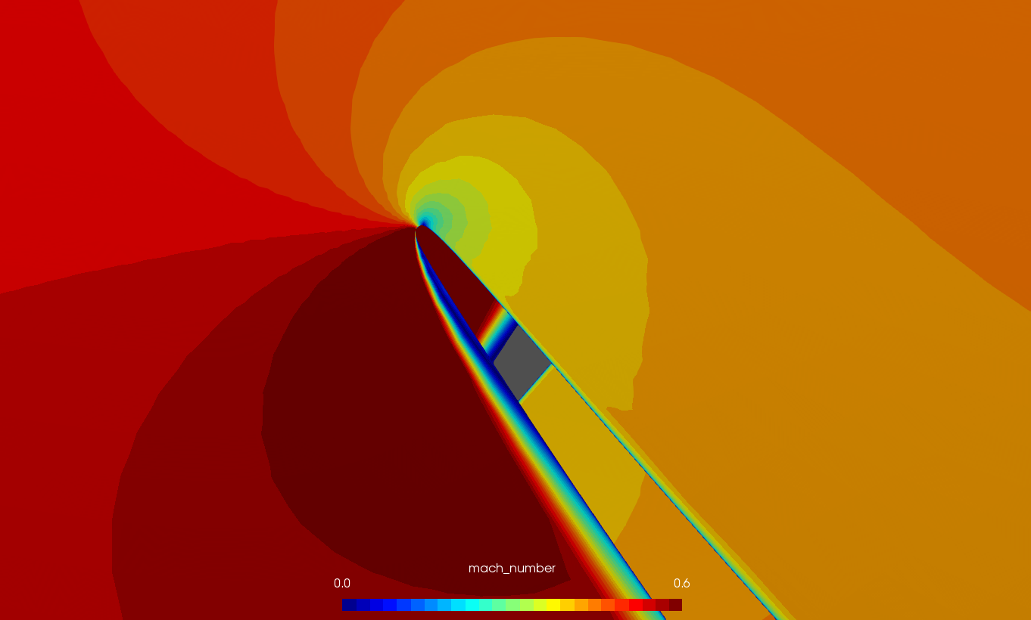
5kpa

Slide 56
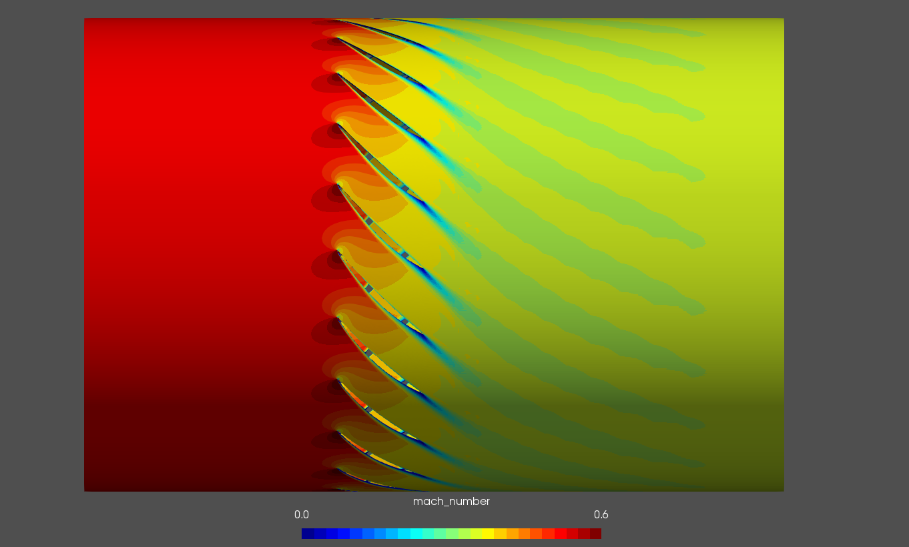
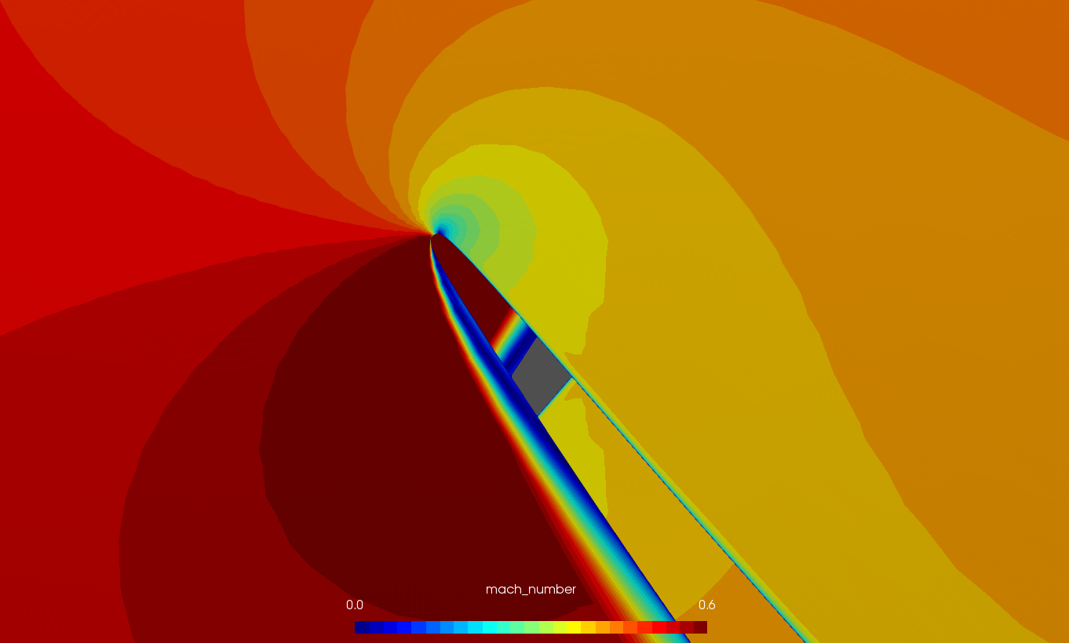
5.2kpa

Slide 57
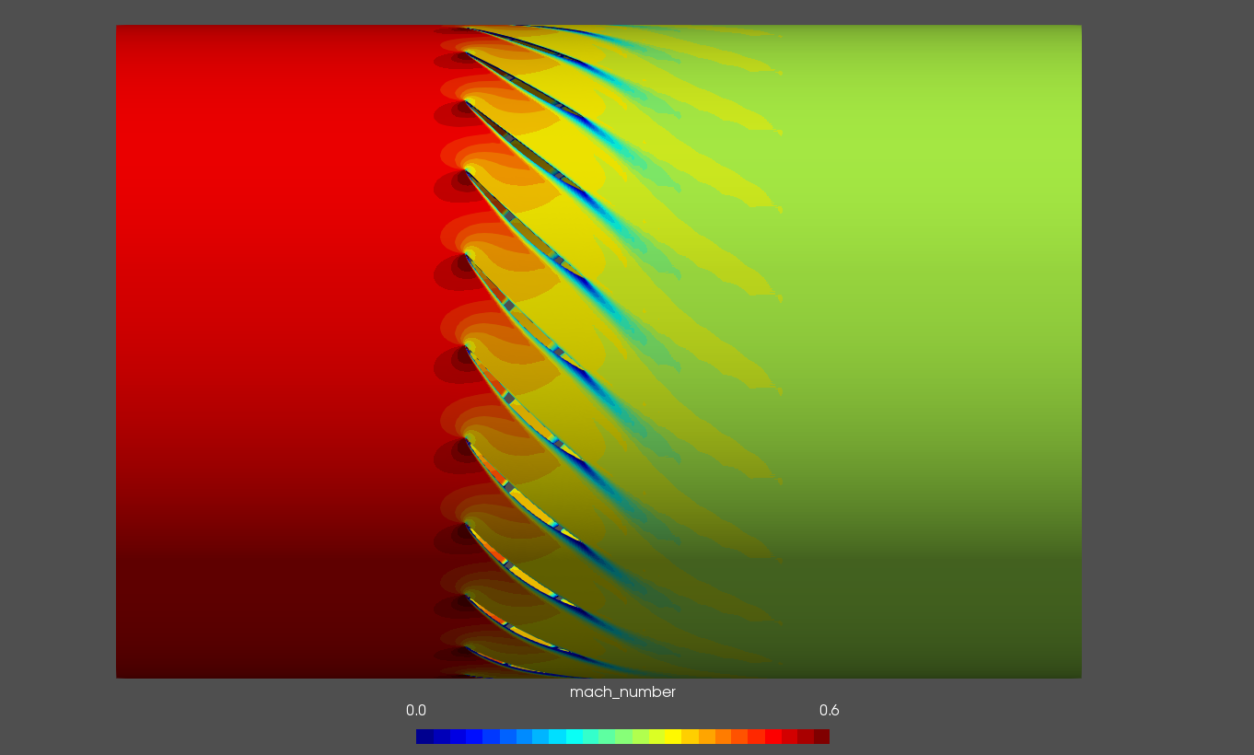
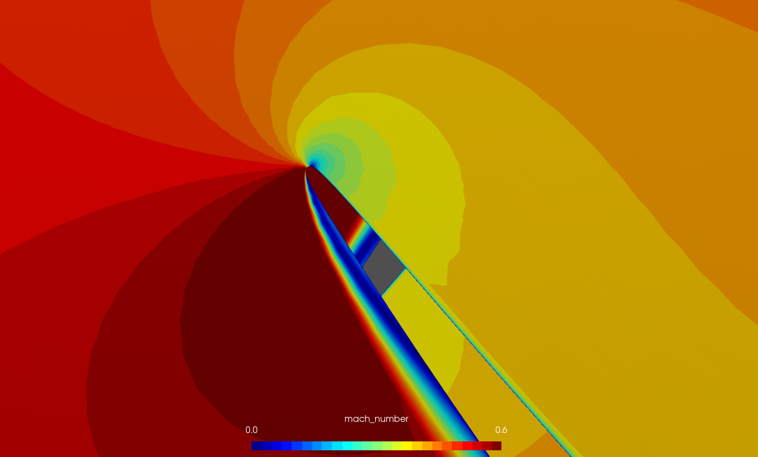
5.3kpa (leading edge separation grows)

Slide 58
5.4kpa (steady state fails to converge)

Slide 59
Steady state performance
Pressure ratio efficiency

Slide 60
eigenvalues
A few eigenvalues are computed for 5.3kpa, the highest back pressure steady state is obtained.
However, no unstable eigenvalues are found yet…

